Slide 1
Securing the Medical Supply Chain: Setting the Stage
Onora Lien
Executive Director
Notes:
Start with role call

Slide 2
“When a disaster hits, Americans rely on a fragmented healthcare system to miraculously mount a timely, cohesive, and effective recovery effort. Yet, the carefully orchestrated and sequenced medical responses to disasters lean on a disjointed health system.”
Closing the Seams: Developing an integrated approach to health system disaster preparedness, Price Waterhouse Coopers - HRI, 2007

Slide 3
Healthcare Delivery System: Complex and Vital
In Washington…
More than 7000 healthcare delivery organizations
Approximately 430,000 licensed healthcare providers

Slide 4
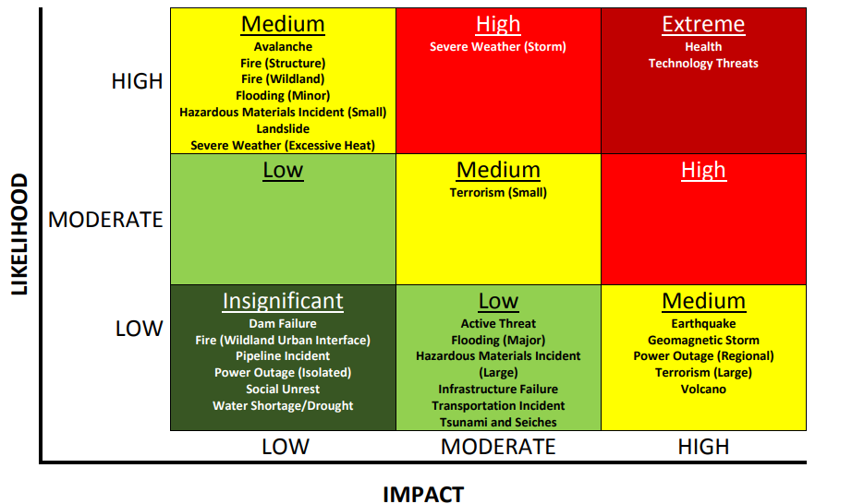
Hazards for Healthcare Delivery System
Source: Northwest Healthcare Response Network Healthcare HVA 2017

Slide 5
Courtesy: ASPR TRACIE “Partnering with Healthcare Supply Chain 2019”

Slide 6
Day to Day Supply Chain Challenges
Industrial: e.g. work stoppages, fluctuating transportation costs, fuel supply issues, geopolitical events, market forces, technological failures, etc. These are especially impactful to production and manufacturing
Operational: production or supply problems such as lack of raw materials, or machine parts, regulatory actions (incl product recall), manufacturing timeframes, product liability challenges, just in time ordering processes, disparate product cycles, data silos between suppliers and providers
Just in time or low unit of measure programs: Frequently relied on by healthcare from their distributors; help reduce costs but lead to fragile supply-demand relationships
Consumer or provider brand (or product) preferences for medications, equipment; consumer distrust in novel medications/vaccines
Adapted from ASPR TRACIE “Partnering with Healthcare Supply Chain 2019”

Slide 7
Supply Chain Hazards, Threats, Vulnerabilities
Healthcare Supply Chain relies on many variables: raw material availability, machinery, parts, workforce, standards compliance, regulatory requirements, contracts, critical infrastructure (power, water, telecommunications, multi-modal transportation, etc)
Many hazards can create or exacerbate these vulnerabilities globally and locally:
Natural Disasters: hurricanes, snowstorms, wildfires, floods, earthquakes
Human Caused Disasters: e.g. cyber attacks, acts of terrorism, oil-spills, transportation incidents, etc
Public Health Threats: e.g. biological threats naturally occurring and intentional attacks
Adapted from ASPR TRACIE “Partnering with Healthcare Supply Chain 2019”

Slide 8
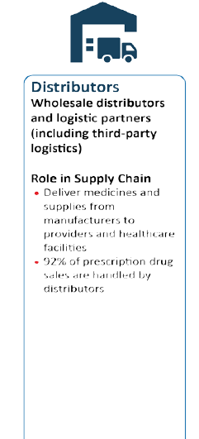
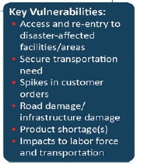

Slide 9
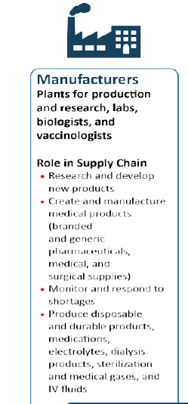
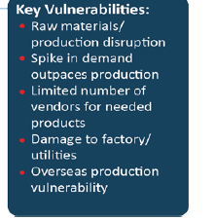

Slide 10
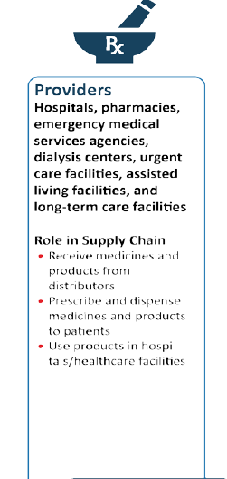
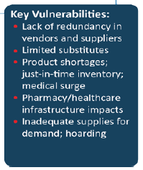

Slide 11
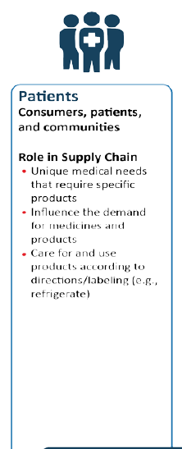
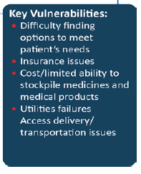

Slide 12
Many efforts to support supply chain resilience
Office of the Assistant Secretary for Preparedness and Response (ASPR)
National Healthcare System Preparedness Program
Strategic National Stockpile
Critical Infrastructure Protection Program
Biomedical Advanced Research and Development Authority
ASPR TRACIE
Federal Emergency Management Agency
Centers for Disease Control
Food and Drug Administration
Numerous private sector efforts among manufacturers, distributors, etc
Local healthcare coalitions!

Slide 13
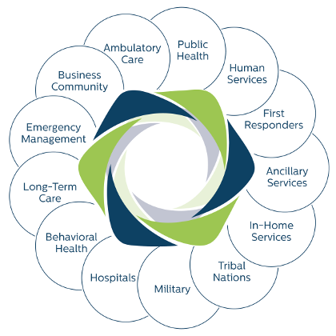
Northwest Healthcare Response Network
We lead regional healthcare collaboration to effectively respond to and recover from emergencies and disasters.
So that…
Our patients and communities get the care they need during and after emergencies and disasters.
www.nwhrn.org

Slide 14
Building resilience locally
Statewide healthcare supply chain workgroup
Information sharing and situational awareness
Strategies for resource conservation, adaptation, substitution, etc for key supplies
Disaster formularies
Statewide and locally planning for logistics, critical infrastructure recovery, transportation access, credentialing, etc post disaster

Slide 15
Thank you!
Onora Lien
Executive Director
Northwest Healthcare Response Network
Onora.Lien@nwhrn.org
425-988-2896 (direct)
www.NWHRN.ORG
@TheNetworkNWHRN

