Slide 1
Securing the Medical Supply Chain
Curry Mayer
Emergency Management
Bellevue

Slide 2
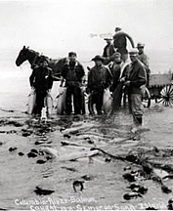
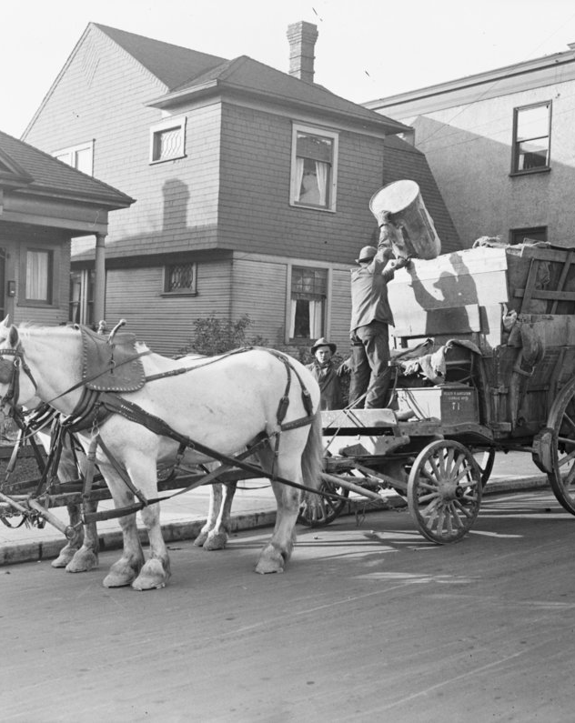
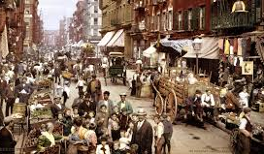
What does Emergency Management have to do with it?
What?
Why does this matter to you?
Disruption!
How do we approach solutions?
Cross Sector Engagement

Slide 3
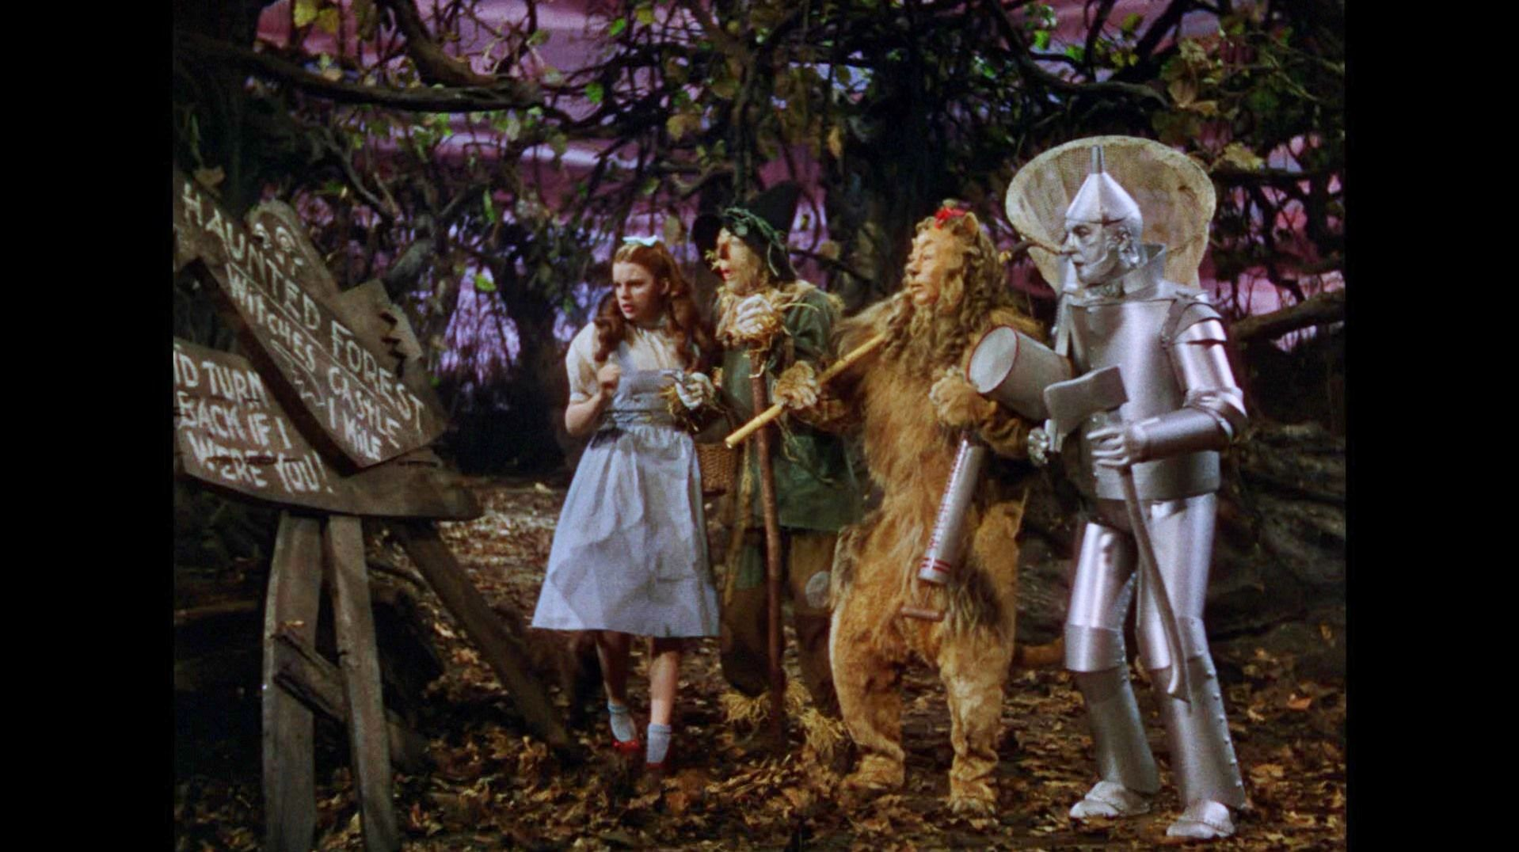
Earthquake, Tsunami, Power Outage! Oh My!
May happen all together
Cascading effects
Long term recovery
Major critical infrastructure damage
And there was a really big snowstorm…

Slide 4
9.5 Earthquake – Chile vs. Cascadia
Cascadia fault is 620 miles vs. Valdivia quake in Chile 621 miles
1960 Valdivia quake left 2 million people homeless
3000 injured, 1,655 killed
Adjusted for inflation more than $2 billion in damages
Accompanied by tsunami that reached New Zealand, Japan, Philippines, & Hawaii – (Hilo, HI 61 people died)
Cascadia fault will produce a tsunami – coastal rescue or delivery of resources will be delayed or impossible
Population today more dense than 1960
How long until we are able to move resources?
Notes:
This is the part that should be scary;..
The Cascadia Subduction Zone (CSZ) is a 1,000 km (620 mi) long dipping fault that stretches from Northern Vancouver Island to Cape Mendocino in northern California. It separates the Juan de Fuca and North America plates. Geologists believe we are overdue for an earthquake on this fault – which of course would impact us. Some predict it could be a 9.5 earthquake.
On May 22, 1960, the most powerful earthquake in recorded history—magnitude 9.5—struck southern Chile. The rupture zone stretched almost 1,000 kilometers (621 miles) along the country’s coast.
The Valdivia earthquake left 2 million people homeless, injured at least 3,000, and killed approximately 1,655. Adjusted for inflation, the economic damage totaled more than $2 billion.
The Valdivia earthquake triggered a massive tsunami that raced across the Pacific. Waves wracked coastal communities as far away as New Zealand, Japan, and the Philippines. In Hawaii, the tsunami devastated the coastal town of Hilo, killing 61 people.

Slide 5
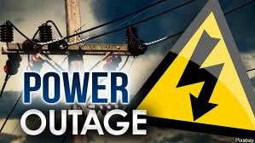
Long Term Widespread Power Outage
Triple threat; solar storm, electro-magnetic pulse (EMP), cyber attack
A month or more – Western grid=western states or all 50 states
Virtually every type of infrastructure will be impacted
Many circuits will be damaged and not simply able to “turn back on”
Water supply and wastewater treatment, Telecommunications and the internet, Food production and delivery, Fuel extraction, refining and distribution, Financial systems, Transportation and traffic controls (land and air traffic), Government (including fire, police, emergency medical services and public works), Hospitals and healthcare, Supply chains

Slide 6
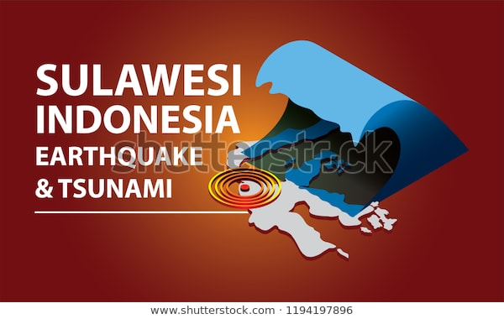
Tsunami
12/26/2004, one of the deadliest tsunamis in recorded history- off the west coast of Sumatra, Indonesia.
Followed 9.1 earthquake – second largest in recorded history!
Coasts of 11 countries
275,00 deaths from direct effects
Afterward, people affected by disease, lack of shelter & no clean water
Notes:
A magnitude 9.1 earthquake triggered waves as high as 15 meters (50 feet) that crashed into the coasts of 11 countries. The direct effects of the tsunami included more than 275,000 deaths and millions of people left homeless. While people from Thailand to East Africa were affected by the tsunami, the Indonesian province of Aceh was hit hardest. Along with the direct effects of the tsunami, many people were affected by disease, lack of shelter, and inadequate nutrition in the aftermath of the disaster.

Slide 7
Pre and Post Earthquake Buildings…
Christ Church

Slide 8
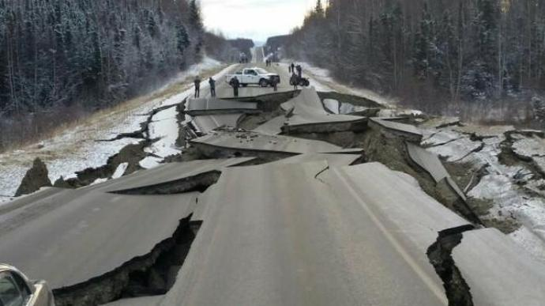
Post Earthquake Road Damage
Alaska, 2011
Notes:
Why do you suppose I chose pictures of building and roadways?

Slide 9
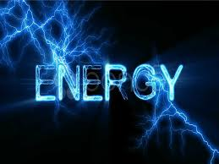
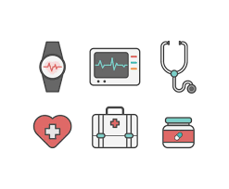
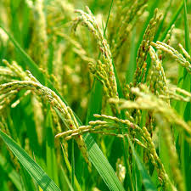
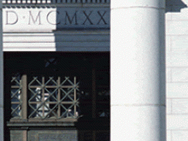
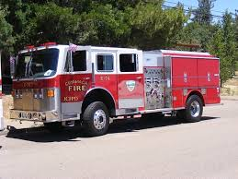
Critical Infrastructure Sectors
Critical infrastructure Sectors are the systems which make up the Nation’s security, public health and safety, and economic vitality every day.
Chemical sector
Manufacturing
Energy
Healthcare Public Health
Communications
Defense industrial base
Agriculture
IT
Nuclear
Commercial
Facilities
Financial Services
Govt Facilities
Water
Dams
Emergency Services
Transportation
Notes:
We know it as the power we use in our homes, the water we drink, the transportation that moves us, the stores we shop in, the bridges that connect us, and the communication systems we rely on to stay in touch with friends and family. More broadly, critical infrastructure refers to the assets, systems, and networks, whether physical or virtual, so vital to the United States that their incapacitation or destruction would have a debilitating effect on our Nation’s way of life.
Does the medical supply chain depend on any of these sectors?

Slide 10
Four Critical Infrastructure Lifelines Water, Energy, Transportation, Communication
Essential systems - without which public health, safety, and economic security cannot exist…
Four main factors that define lifelines:
Necessary Services
Disruption life-threatening
Interconnected within & across multiple sectors
Disruption may effect others with cascading effects
Do Disasters Impact these lifelines?
How are lifelines related to the medical supply chain?
Notes:
Provide necessary services and goods that support every home, business and sector
Disruption of the service has the potential to develop life-threatening situations, 
Involve complex physical and electronic networks - interconnected within & across multiple sectors
Disruption of one lifeline has the potential to effect or disrupt other lifelines in a cascading effect.

Slide 11
We Are All Connected…
Interdependencies - Lifelines do not operate in a silo; they are highly interconnected and dependent on one another
At the Federal level
Cross-sector risk analysis
Planning, and strategic interagency and industry partnership efforts
Effort to both defend critical infrastructure and ensure its resilience
National Infrastructure Protection Plan
National Cyber Strategy
National Priorities for Infrastructure Security & Resilience

Slide 12
Now What? What Can You Do?
Supply chain mapping!
Documents the source of materials, storage, transportation and distribution of products.
Enables transparency throughout the supply chain
Provides insights into vulnerabilities, potential risks
Allows for development and implementation of proactive mitigation strategies.
Collaborate across sector lines
Combine preparedness & mitigation efforts
Notes:
Modern supply chain mapping is the process of engaging across companies and suppliers to document the exact source of every material, every process and every shipment involved in bringing goods to market. Accurate supply chain mapping only became possible with the rise of online maps and the social web.

Slide 13
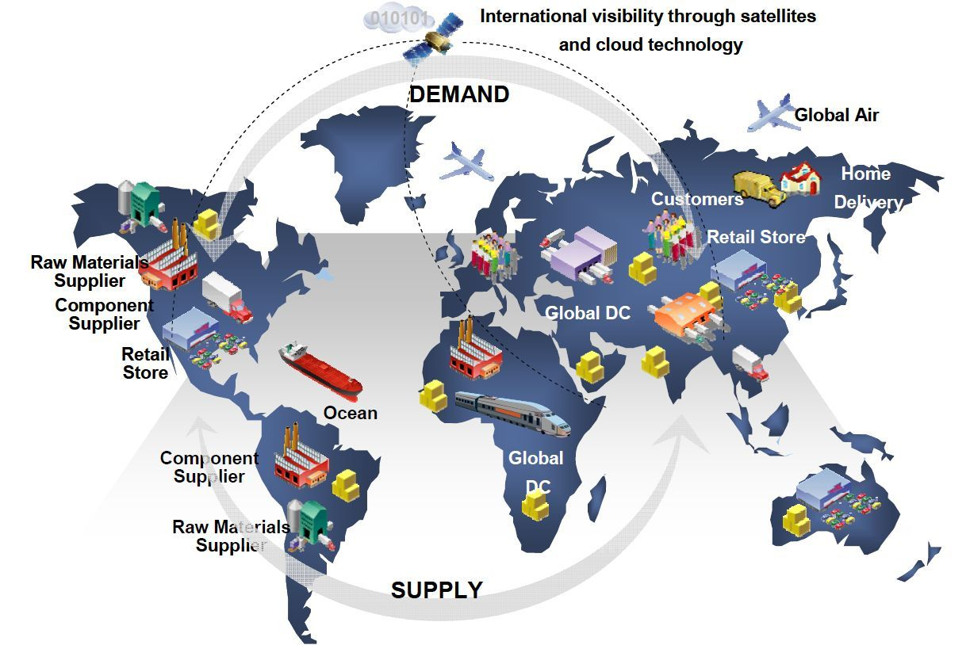
Simple or Complex…

Slide 14
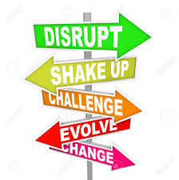
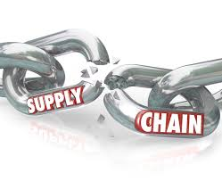
Disruption of the Status Quo!
Should you be concerned about the resilience of the Medical Supply Chain?
Uncomfortableness can drive action!
Shared understanding, shared responsibility, shared actions
You are only as strong as your partners are
You must be flexible & look for ways to adapt
What we do in emergency management!

Slide 15
Securing the Supply Chain…
Questions?
Curry Mayer
Bellevue Emergency Management
425) 452-2816
cmayer@bellevuewa.gov

